Slide 1
Reve Soil AI
Team name: Data Pirates
Leader: Harvy Doshi
Bhimani Yatra
Drashti Vaghasiya
Heli Detroja

Slide 2
Architecture
pH : Transformer Encoder Model (Uses self-attention for regression tasks)
Ideal wavelength : 435,460,560,705,860,680 (nm)
Nitro: Random Forest Regressor (Tree-based ensemble method)
ideal wavelength : 645, 705, 680, 585, 560 (nm)
Pota Nitro(1): Gradient Boosting Regressor (Boosting-based regression model)
ideal wavelength : 410,460,510 (nm)
Pota Nitro(2): Neural Network with Multi-Head Attention (Deep learning model with Swish activation)
ideal wavelength : 410,460,510 (nm)
Posh Nitro: Fully Connected Regression Head (Used in different architectures for continuous output prediction)
Ideal wavelength : 460, 860 (nm)

Slide 3
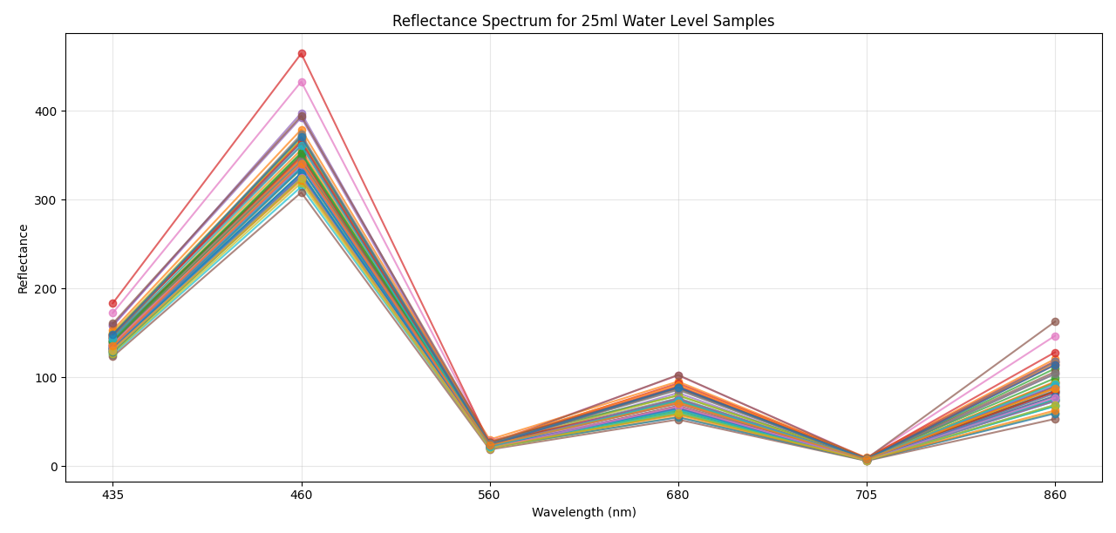
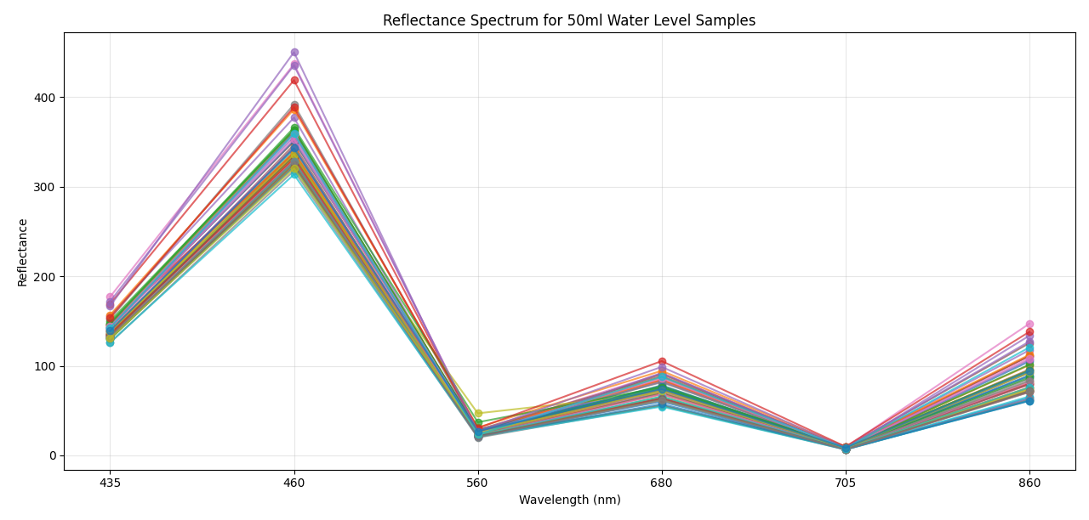
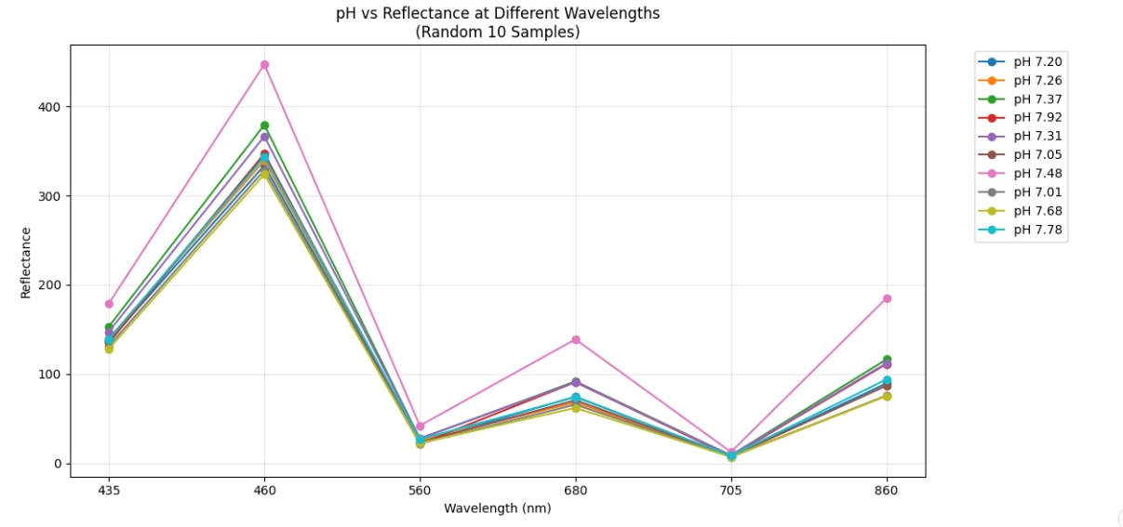
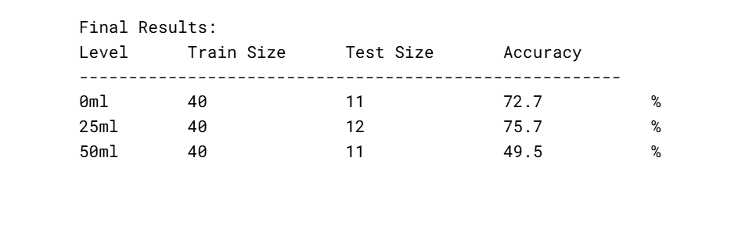
pH: Results: 0ml, 25ml, 50ml

Slide 4
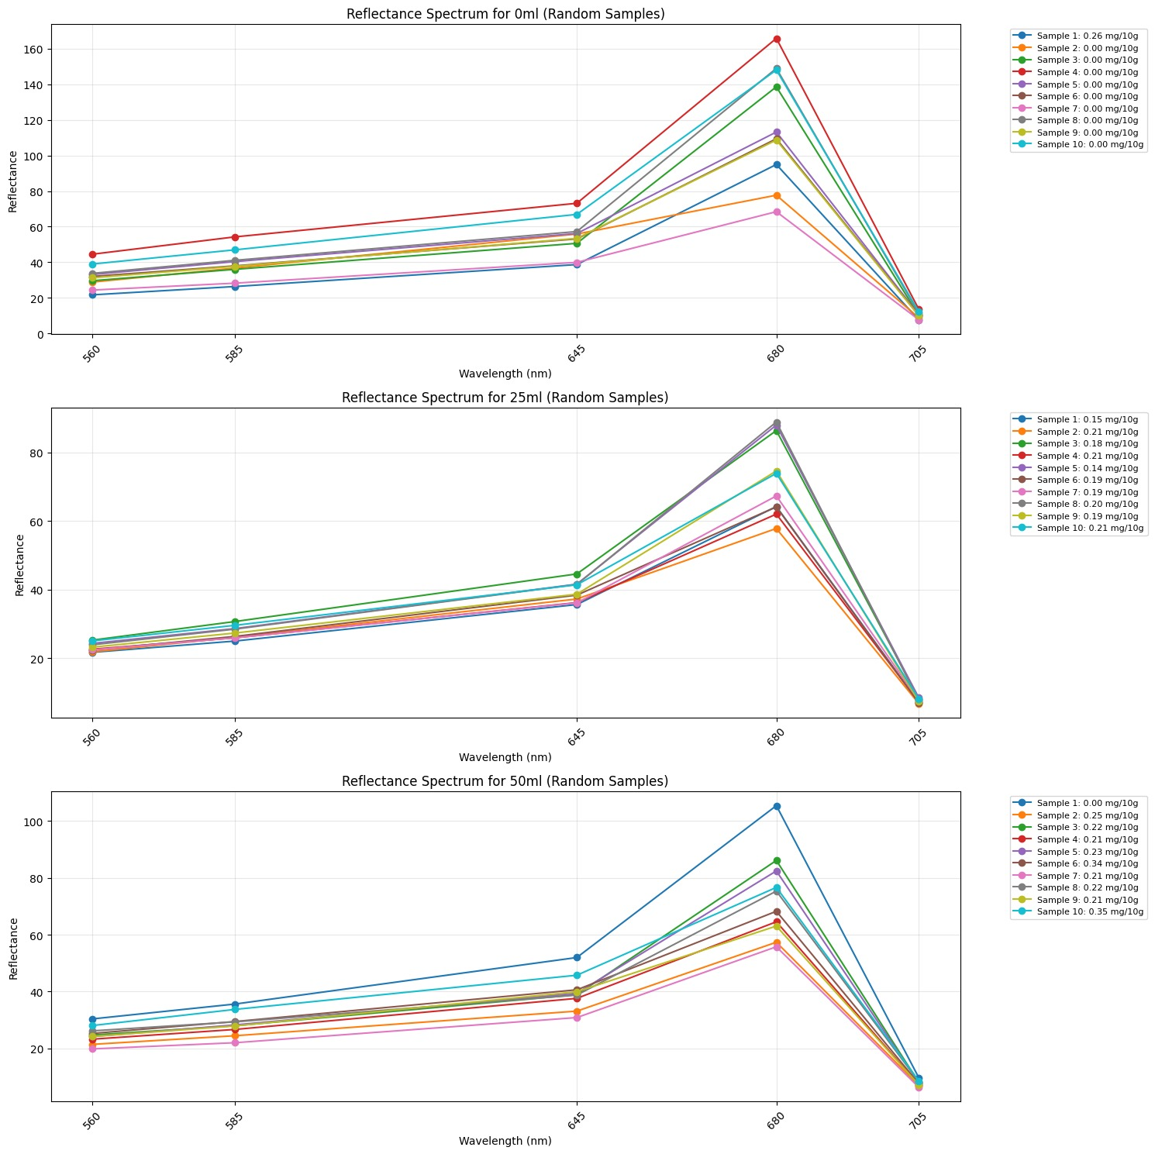
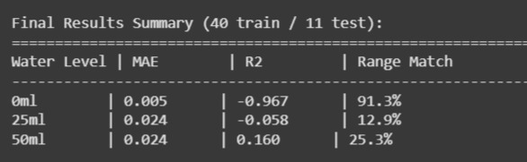
Nitro: Results: 0ml, 25ml, 50ml

Slide 5
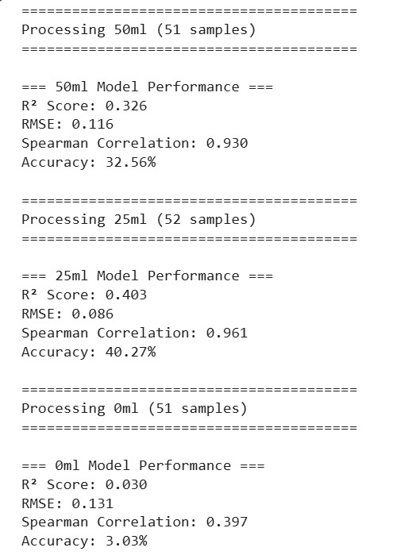
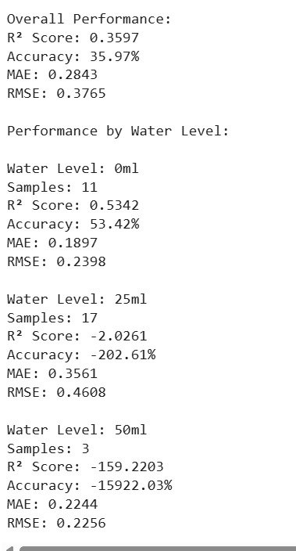
Pota Nitro: Results: 0ml, 25ml, 50ml

Slide 6
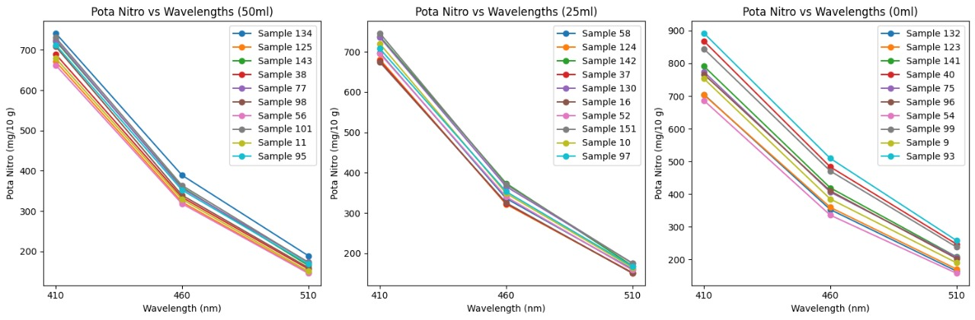
Pota Nitro: Results: 0ml, 25ml, 50ml

Slide 7
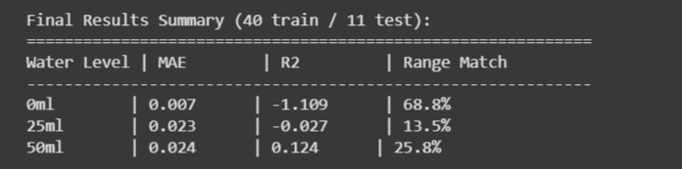
Posh Nitro: Results

